Slide 1
OVERVIEW OF RAPID APPLICATION DEVELOPMENT
-ANUBHAV SINGH
-500061718
- Roll no. 10

Slide 2
WHAT IS RAD ?
Rapid application development is a form of Agile software development technology. Unlike Waterfall methods, RAD emphasizes working software and user feedback over strict planning and requirements recording.
In other words, RAD is less talk, more action. Oh, and testing. Lots and lots of testing.

Slide 3
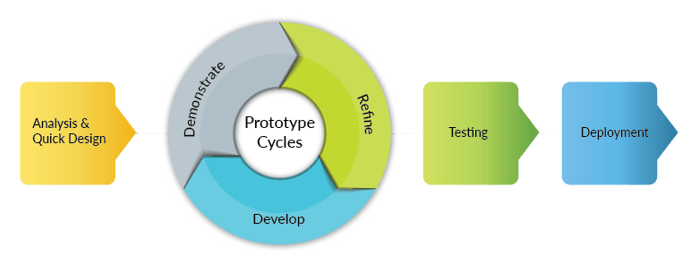
PROCESS……

Slide 4
Phase 1: Requirements planning
During this stage, developers, clients (software users), and team members communicate to determine the goals and expectations for the project as well as current and potential issues that would need to be addressed during the build.
A basic breakdown of this stage involves:
Researching the current problem
Defining the requirements for the project
Finalizing the requirements with each stakeholder’s approval.
By getting approval from each key stakeholder and developer, teams can avoid miscommunications and costly change orders down the road.

Slide 5
Phase 2: User design
During this phase, clients work hand in hand with developers to ensure their needs are being met at every step in the design process. It’s almost like customizable software development.
All the bugs and kinks are worked out in an iterative process.
Developer designs a prototype , the client (user) tests it.

Slide 6
Phase 3: Rapid construction
Prototypes and beta systems are converted into the working model.
Because the majority of the problems and changes were addressed during the thorough iterative design phase, developers can construct the final working model more quickly
The phase breaks down into several smaller steps:
*Preparation for rapid construction
*Program and application development
Coding
*Unit, integration, and system testing
This third phase is important because the client still gets to give input throughout the process. They can suggest alterations, changes, or even new ideas that can solve problems as they arise.

Slide 7
Phase 4: Cutover
This is the implementation phase where the finished product goes to launch. It includes data conversion, testing, and changeover to the new system, as well as user training.
All final changes are made while the coders and clients continue to look for bugs in the system.

Slide 8
PROS..
1. Quick Delivery:
Since the entire project is divided into modules and each module is treated as a separate prototype the time spent in delivering is considerably reduced. Each prototype undergoes a separate testing phase and all components are finally winded together to create the final application. This ensures faster delivery of the software with lesser bugs.
2. Faster Market Analysis:
Since each prototype can be tested by its end user it becomes easier to survey the prospects for suggestions and improvements. Any change is easy to incorporate as it will affect one model of the application and not the entire development in one go.
3. User Feedback:
In traditional waterfall development, app development delays can result in very late arrival of the product. The idea might become obsolete or get stolen by the competitors. By using the MVP philosophy of development the need and psychology of the user are analyzed and further development is carried on only if the market seems fit.
4. Ease to incorporate changes:
Several elements of the application are processed at the same time. Since there is no process form of management, the application changes are easier to incorporate. Unlike waterfall development, the developers need not take a back step if changes are suggested in the product.
5. System Integration:
All the modules of the application are integrated from the very beginning leading to lesser issues in the final integration process. This leads to fewer bugs because all modules are properly synchronized from the very beginning.

Slide 9
CONS..
Early RAD systems had two primary disadvantages:
Reduced Scalability, and reduced features. Reduced scalability occurs because a RAD developed application starts as a prototype and evolves into a finished application.
Reduced features occur due to time boxing, where features are pushed to later versions in order to finish a release in a short amount of time.

Slide 10
THANK YOU

